Slide 1

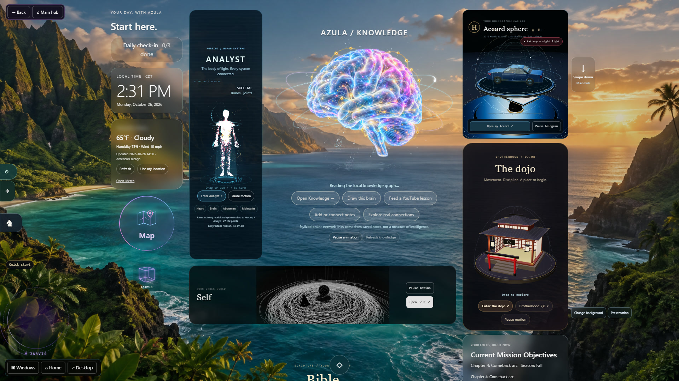
AZULA
01
Azula.
We Go Beyond.
A visual workspace to maintain self‑care, structure your work and build your business, so you can go beyond.
Azula’s real main menu · every widget opens a center in the live demo
Jeremiah White
Founder of Azula
Live demo · azula-by-jeremiah-white.copperball24.chatgpt.site
Notes:
Azula is a working local prototype for a visual personal workspace. The proposed initial focus is adults learning complex material and making projects. This is a focused investor narrative, with the broader product catalog in the appendix. Moltd was supplied as a structural example only. None of its traction, valuation, customers or founder history is attributed to Azula.
Product evidence: dated local application captures and capability audit, 21 October 2026. Public research checked 21 October 2026. Founder facts updated 25 October 2026. LinkedIn: https://www.linkedin.com/in/jeremiah-white-a90012283. Instagram: https://www.instagram.com/jeremiahwhiteee/. Business hypotheses and targets are proposals, not results. Founder identification: Jeremiah White, Founder of Azula. Venture not yet incorporated.
The founder reported brand management and tracking on 25 October 2026. Specific workflows and data integrations still need demonstration. Corporate use is a proposed customer segment, with no corporate customer or enterprise readiness claim.
Updated 26 October 2026 to match the demo website. Images are real captures from the local prototype (personal details blurred); Business HQ screens use sample entries, not a real company’s figures. The cover now shows Azula’s real main menu, as on the demo website’s hero, and links to the live demo: https://azula-by-jeremiah-white.copperball24.chatgpt.site/#interactive-demo

Slide 2

AZULA
02
Scattered information slows useful work
Azula brings self-care, a human analyst, project work, practice and a workspace for your business to thrive and go beyond.
Scattered context
Repeated setup
Unfinished output
Notes, PDFs and saved videos accumulate across separate tools.
Sources, priorities and project context need to be rebuilt each session.
Saved information needs a path into practice and completed projects.
Four potential-customer interviews so far. The problem and willingness to pay need further validation.
Notes:
Product hypothesis drawn from the development goals: a learner saves material in several places, then must reassemble its context before applying it. The founder reports four potential-customer interviews. No quantified time-saving evidence has been supplied. Proposed initial user: an adult student or independent maker with an ongoing project.
Product evidence: dated local application captures and capability audit, 21 October 2026. Public research checked 21 October 2026. Founder facts updated 25 October 2026. LinkedIn: https://www.linkedin.com/in/jeremiah-white-a90012283. Instagram: https://www.instagram.com/jeremiahwhiteee/. Business hypotheses and targets are proposals, not results. Founder identification: Jeremiah White, Founder of Azula. Venture not yet incorporated.

Slide 3

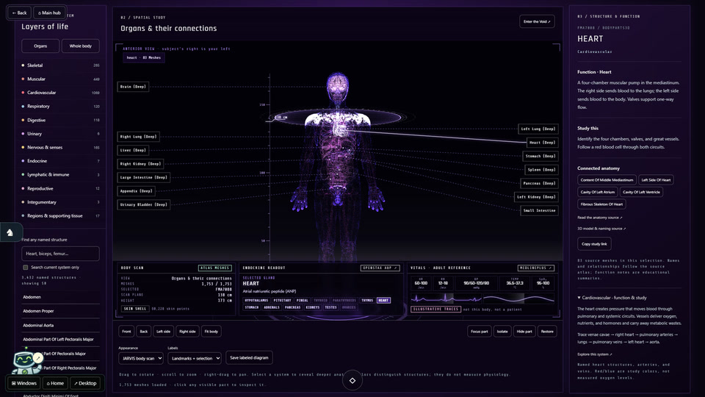
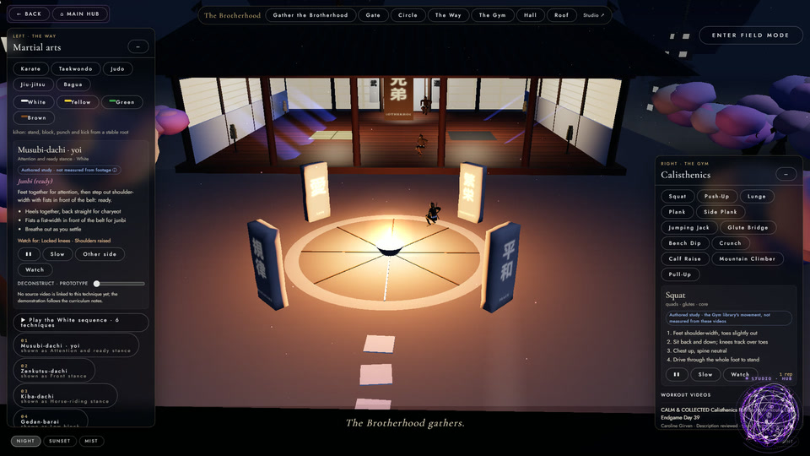
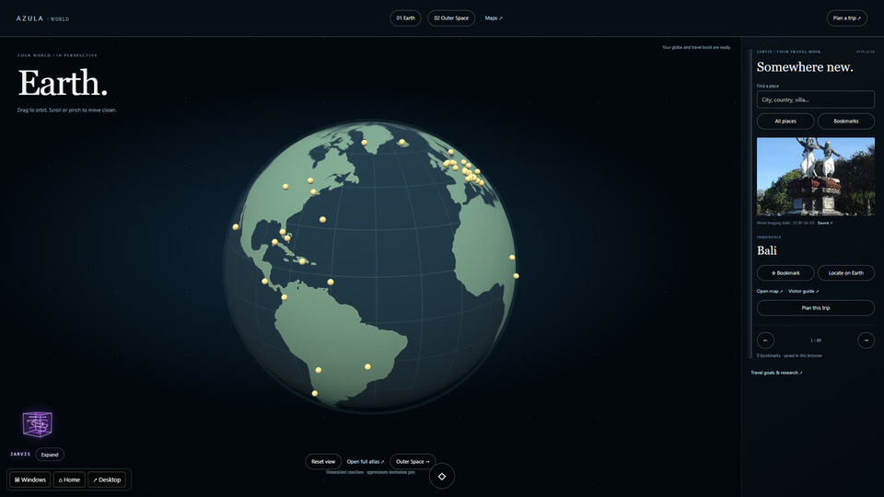
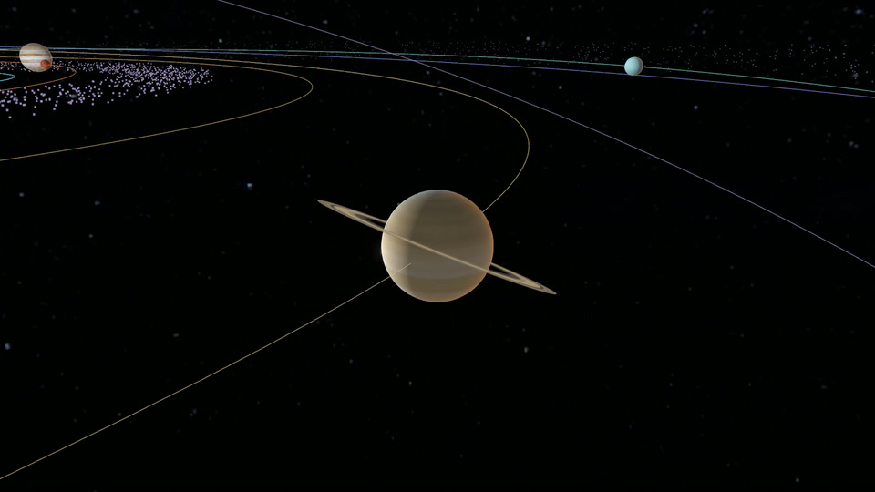
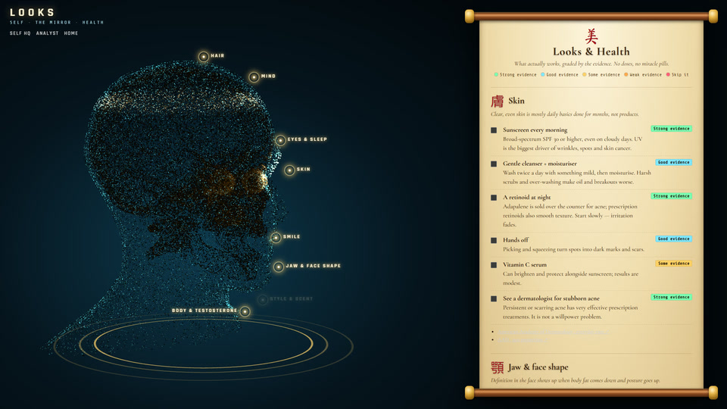
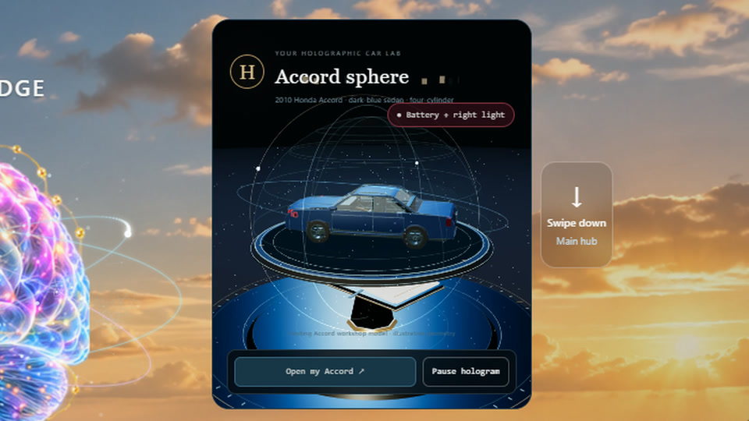
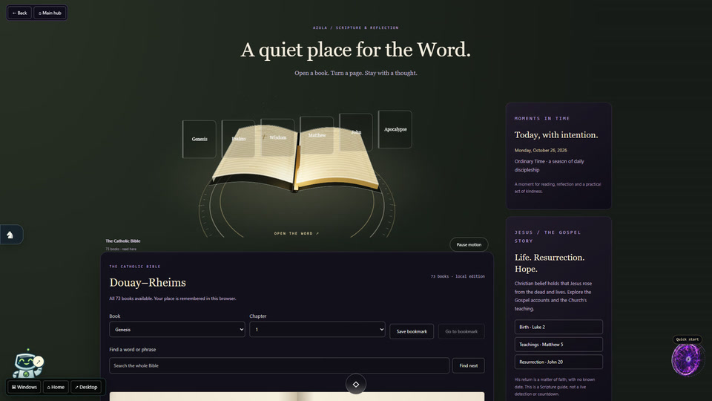
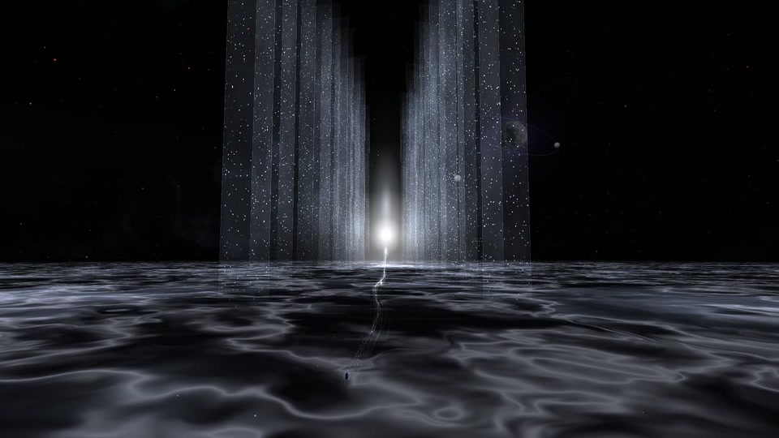
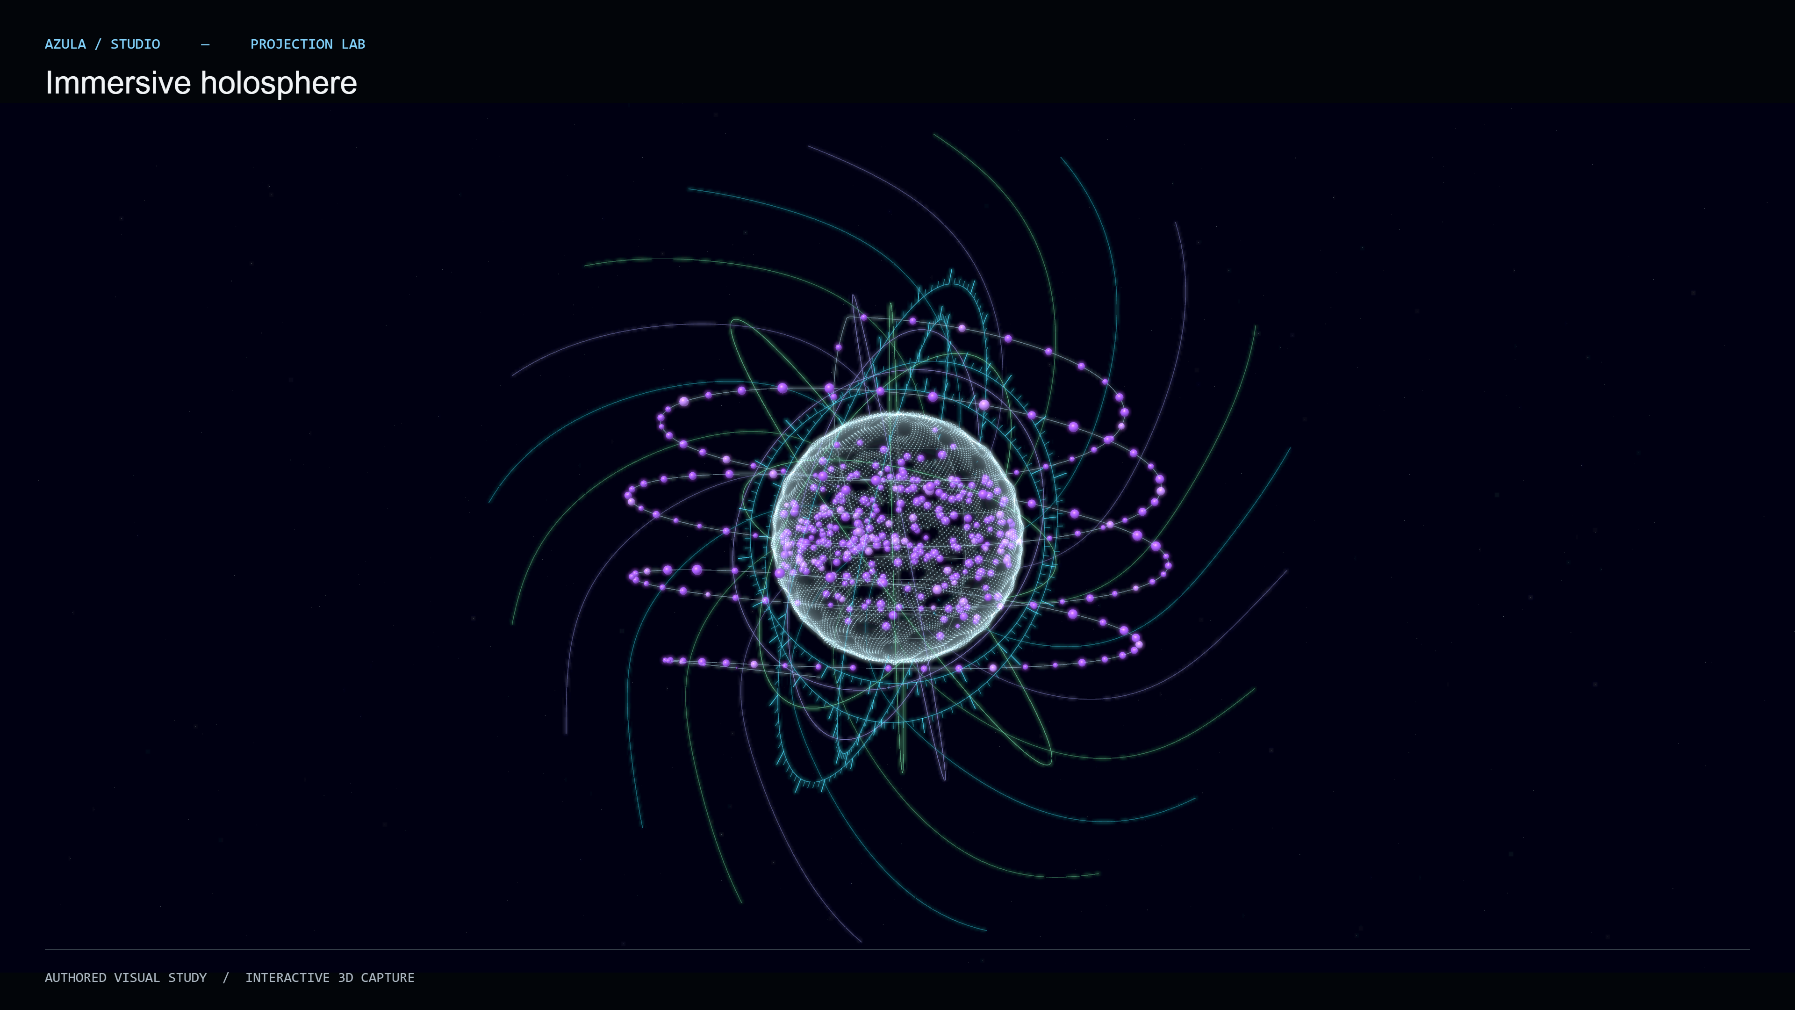

AZULA
03
Every center in one visual workspace
Real captures from the local prototype. Each one opens in the live demo.
Analyst · anatomy & your health
Dojo · 5 martial arts
Earth · 69-place travel book
Outer Space · solar system
Self · meals & looks
Car sphere · repairs & dates
Bible · 73 books
The Void · 10 worlds
Analyst is for everyone: you don’t need to be a nursing major to learn anatomy and keep tabs on your health. Captures have personal details removed.
Notes:
Updated 26 October 2026 to match the demo website. Images are real captures from the local prototype (personal details blurred); Business HQ screens use sample entries, not a real company’s figures. New slide. Earth and Outer Space are separate centers. Self: Looks & Health (evidence-graded skin and health basics, no doses), recipes saved from reels with printable cards, and a daily food log for meal planning. Car sphere: a 203-part 3D model of the founder’s own car with repair records (symptom, plan, priority, cost, target date) across 10 vehicle systems; open repairs are flagged on the main menu; live OBD readings need a compatible adapter. Analyst is for everyone, not only nursing majors: a place to learn anatomy and keep tabs on your health. It has 3,432 named structures across 11 body systems, an optional 18-milestone nursing path and 118 elements (BodyParts3D, CC BY 4.0; educational, not diagnostic). Dojo: karate, taekwondo, judo, jiu-jitsu and bagua, 170 catalogued techniques as authored 3D studies, not motion capture or coaching. Map: 242 countries and territories, OpenStreetMap city maps and the user’s own pins. World: a 3D globe with a 69-place travel book and the solar system with orbit playback; nothing is booked and there is no live satellite link. Bible: the Douay-Rheims text, 73 books. The Void: authored 3D worlds reached from the Crossing.

Slide 4
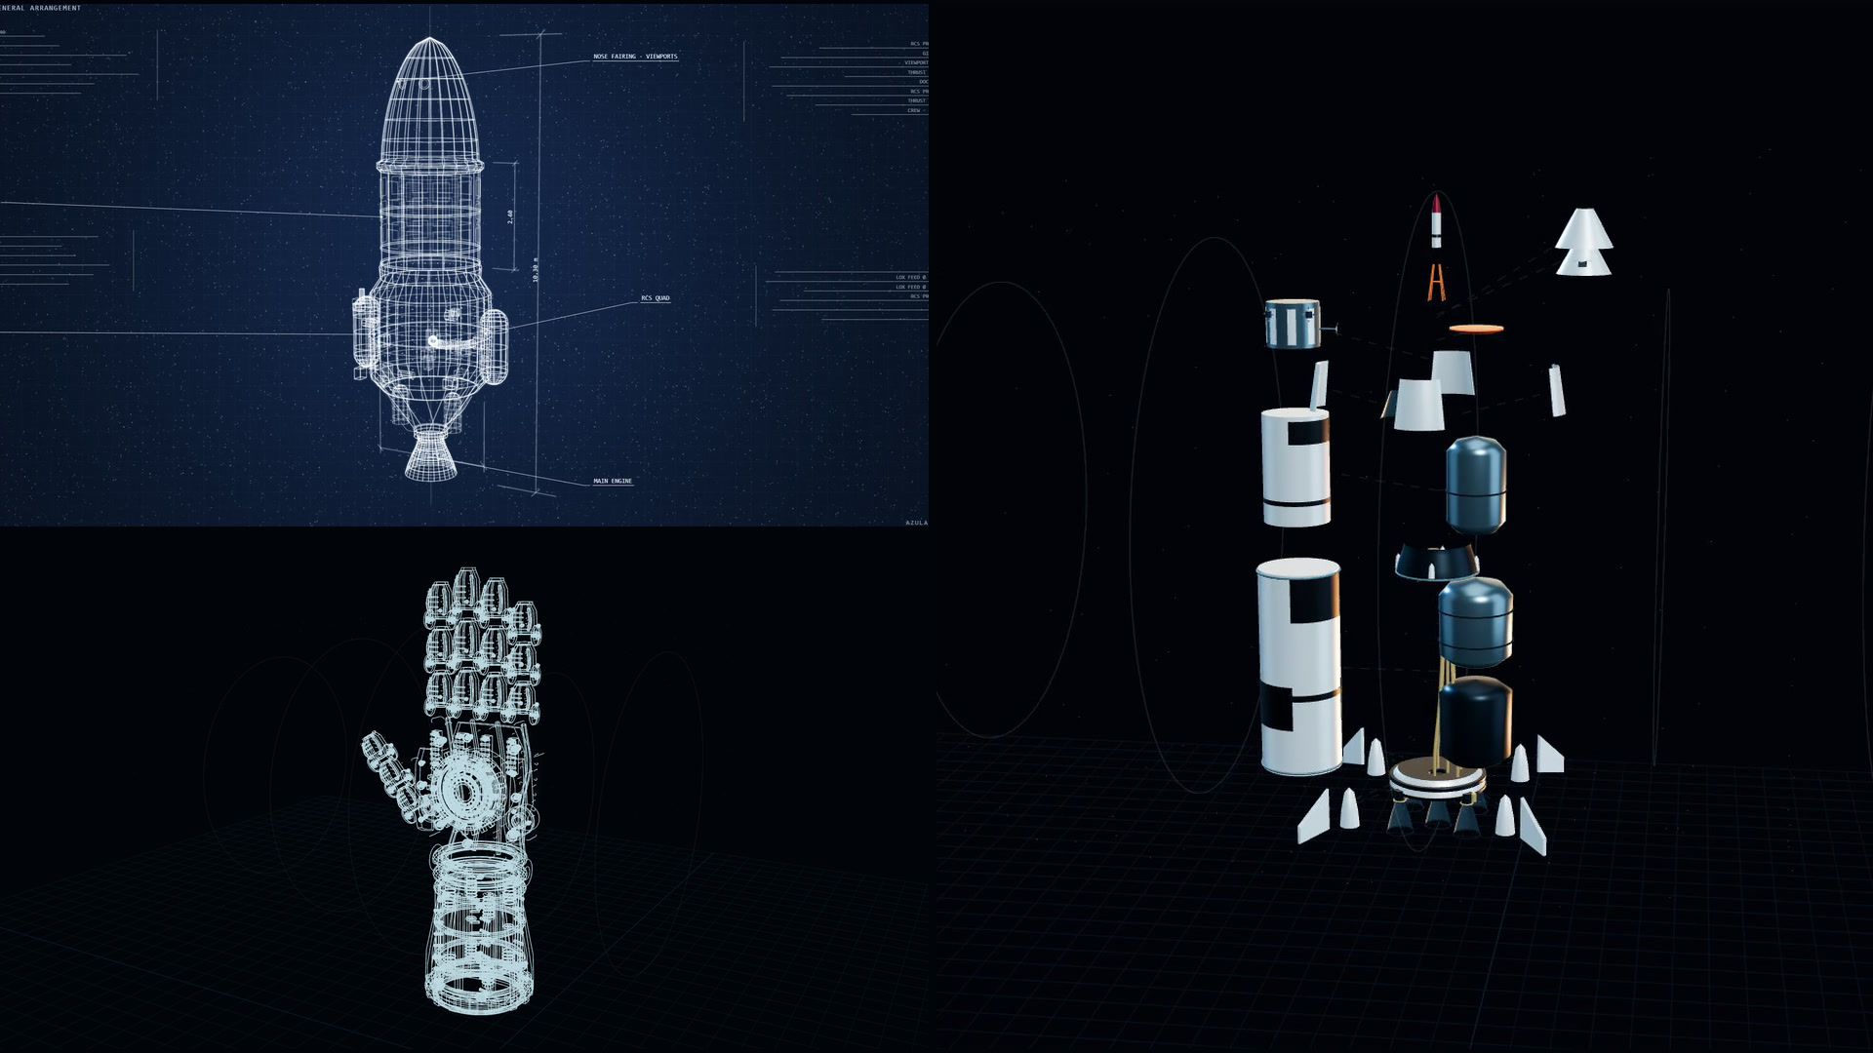
AZULA
04
Studio turns blueprints into 3D builds
Blueprints · Mark I
3D builder · Mark II
Draw it.
Build it.
Take it apart.
Mark I draws the blueprint. Mark II builds the 3D model from selectable parts, like this 33-part rocket.
Real Studio captures: rocket blueprint sheet and gauntlet blueprint, beside the launch vehicle taken apart. Original study models.
Notes:
Local Studio demonstration captured 25 October 2026. The round holosphere has purple balls traveling along an inward spiral and bouncing inside its core. Teal and silver outer swirls rotate independently. Orbit, zoom, pause and guided inspection work in the local prototype. This is an authored visual study, not measured data or a scientifically validated molecular simulation. The still is a direct 3840 x 2160 native Studio export. A separate local recording demonstrates motion.
Updated 26 October 2026 to match the demo website. Images are real captures from the local prototype (personal details blurred); Business HQ screens use sample entries, not a real company’s figures. Studio Prototype desk, captured 26 October 2026 in Material style. The launch vehicle has 33 selectable parts; every model deconstructs, isolates and rebuilds part by part. Mark I draws blueprint sheets stroke by stroke. These are original visual study models, not real vehicles, weapons or engineering designs.

Slide 5
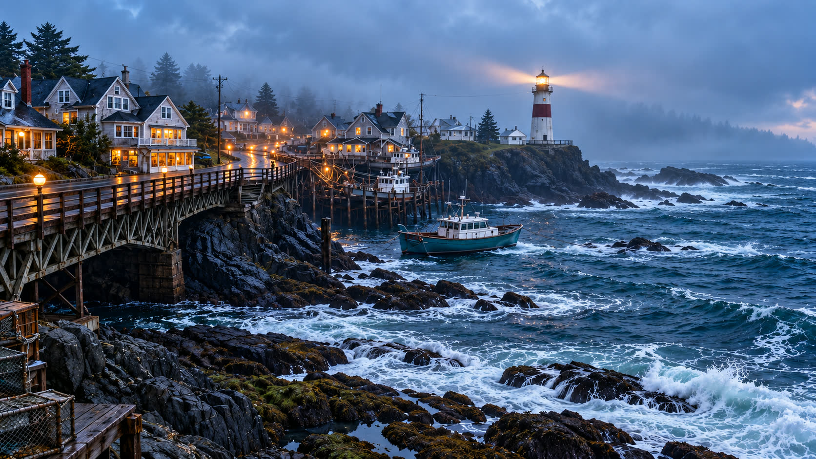
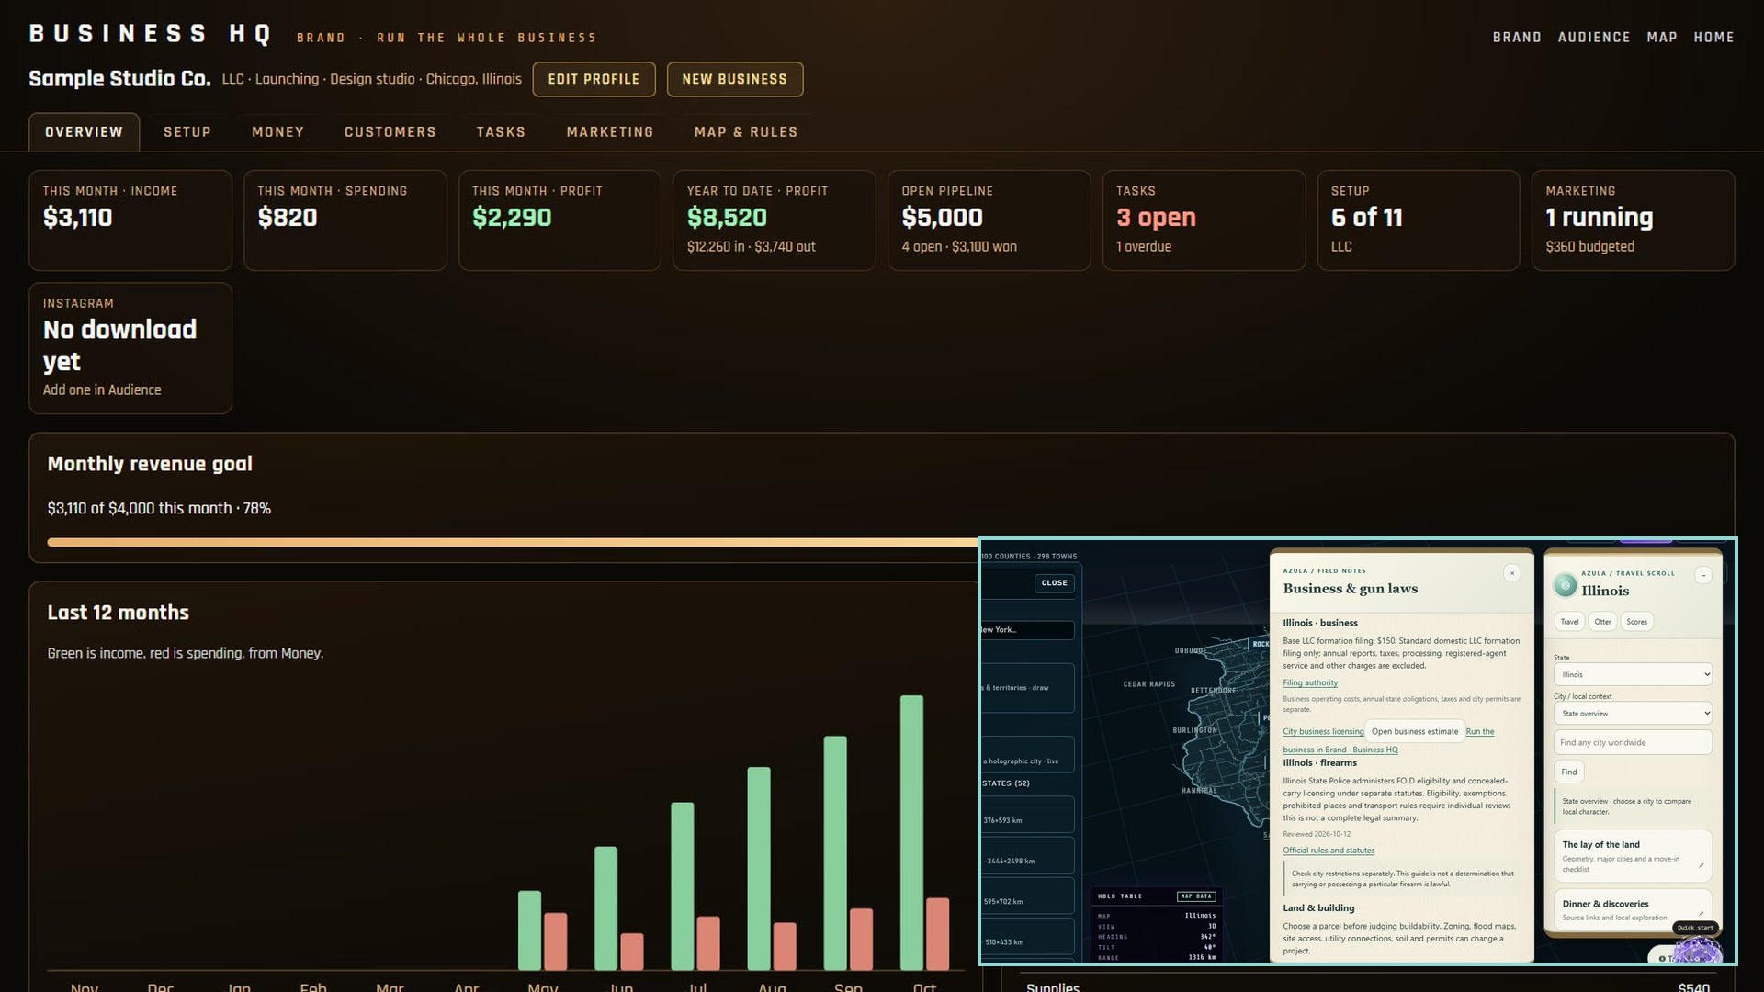
AZULA
05
Brand and Map help you start a business
Pick where.
Check the rules.
Form the LLC.
Run it.
Business HQ tracks setup, money, customers and marketing. The Map shows each state’s LLC filing and local rules.
Real Business HQ capture with sample entries, and the Map’s Business & gun laws notes. Planning and record keeping, not legal or tax advice.
Notes:
Updated 26 October 2026 to match the demo website. Images are real captures from the local prototype (personal details blurred); Business HQ screens use sample entries, not a real company’s figures. New slide. Business HQ (Brand › Business, /brand/business in the hub, built 26 October 2026) covers several businesses, each with an 11-step setup checklist (structure, name, registered agent, state filing, operating agreement, EIN, bank account, state taxes, licences, bookkeeping, annual reports) linked to official SBA, IRS and state pages; a money ledger with monthly profit, a 12-month chart and CSV export; a customer pipeline; tasks; marketing campaigns; and a watch list. Its Map & rules tab uses the same notes as the Map’s travel scroll: verified LLC filing fees for four states so far (CA, FL, IL, TX), city licensing links, and firearms notes reviewed for Illinois, with official sources linked for every state. Nothing is filed, paid or sent automatically. The screens show sample entries; there are no business users yet.

Slide 6
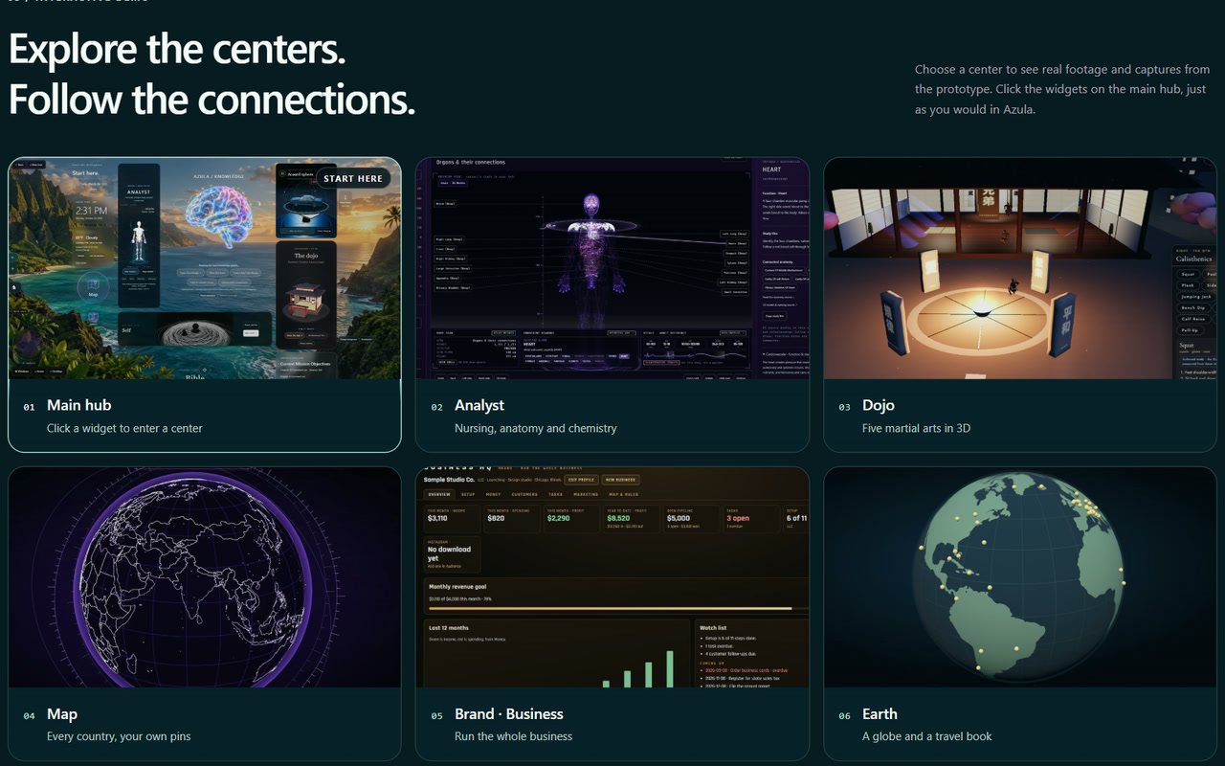
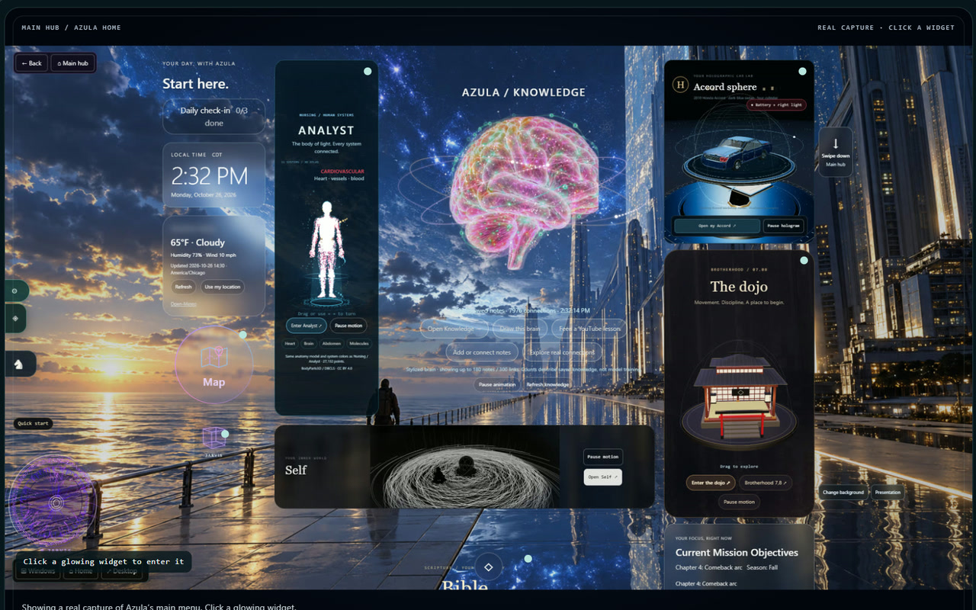
AZULA
06
Try it: the new Azula demo
Open every center on the website: real footage, clickable widgets, nothing to install.
12 centers · pick one
Main hub · click a widget
Live demo · azula-by-jeremiah-white.copperball24.chatgpt.site
Real captures of the demo website. Centers show real prototype footage; Business HQ uses sample entries.
Notes:
Updated 26 October 2026 to match the demo website. Images are real captures from the local prototype (personal details blurred); Business HQ screens use sample entries, not a real company’s figures. New slide: the demo website, rebuilt 26 October 2026. It shows 12 centers (main hub, Analyst, Dojo with the Brotherhood campus, Map, Brand · Business HQ, Earth, Outer Space, Self, Car sphere, Bible, Studio Mark II and the rocket), an Atlas that breaks down every center, the Void’s ten worlds, both studios, the start-a-business walkthrough and this pitch deck. Link: https://azula-by-jeremiah-white.copperball24.chatgpt.site/#interactive-demo

Slide 7

AZULA
07
An initial focus on adult learners and makers
Annual subscription revenue (USD)
15.8M
US undergraduates
in the reference population
Initial pilot: learners and makers.
Corporate brand use is a further opportunity to validate.
Hypothetical paid share of the reference population
NCES: fall 2023 enrollment. Revenue bars are scenarios at an assumed $15/month, not a forecast.
Notes:
Recommended initial segment: US students aged 18+ and independent makers. NCES Condition of Education 2025 reports 15.8 million total undergraduate enrollments in fall 2023. This is a broad reference population, includes people outside the proposed 18+ niche and is not a validated SAM. At assumed $15/month, the entire 15.8m base would imply $2.844b annual capacity. A hypothetical 10% relevant subset is 1.58m/$284.4m annual capacity, but that share is unvalidated and is not used as a claimed market size. Chart: hypothetical paid shares of 0.01%, 0.05%, 0.10% of 15.8m = 1,580, 7,900, 15,800 paying users. Multiplying by $15*12 gives $284,400, $1,422,000, $2,844,000. No timing, conversion, distribution or attainability is implied.
Source: https://nces.ed.gov/use-work/resource-library/report/compendium/learn-about-new-condition-education-2025-part-i
Product evidence: dated local application captures and capability audit, 21 October 2026. Public research checked 21 October 2026. Founder facts updated 25 October 2026. LinkedIn: https://www.linkedin.com/in/jeremiah-white-a90012283. Instagram: https://www.instagram.com/jeremiahwhiteee/. Business hypotheses and targets are proposals, not results. Founder identification: Jeremiah White, Founder of Azula. Venture not yet incorporated.
The corporate brand opportunity is outside the undergraduate reference population and is not included in this chart. No corporate market size is asserted.
Visual treatment updated 25 October 2026 from the founder-supplied monochrome signal-terrain reference: black plotting field, white point texture, fine wire outlines and dotted measurement grid. Chart values, categories, units and scenario assumptions are unchanged. These figures remain illustrative scenarios, not forecasts.

Slide 8

AZULA
08
Proposed pricing and revenue scenarios
Annual subscription revenue (USD)
Free exploration
Paid personal workspace
Test $10, $15 and $20 monthly.
Meter heavy AI generation separately. Business pricing needs validation.
Illustrative annual revenue at 2,000 paying users. Prices and demand remain unvalidated.
Notes:
Proposed model, not current pricing or revenue: free exploration, a personal subscription and separately metered compute-heavy generation. Test $10, $15 and $20 per month. At 2,000 paying users the annualized subscription scenarios equal $240k, $360k and $480k. Gross margin is unknown until model/API, storage, hosting, payments, support and licensed-content costs are measured. No growth rate, retention or acquisition efficiency is assumed.
Product evidence: dated local application captures and capability audit, 21 October 2026. Public research checked 21 October 2026. Founder facts updated 25 October 2026. LinkedIn: https://www.linkedin.com/in/jeremiah-white-a90012283. Instagram: https://www.instagram.com/jeremiahwhiteee/. Business hypotheses and targets are proposals, not results. Founder identification: Jeremiah White, Founder of Azula. Venture not yet incorporated.
Visual treatment updated 25 October 2026 from the founder-supplied monochrome signal-terrain reference: black plotting field, white point texture, fine wire outlines and dotted measurement grid. Chart values, categories, units and scenario assumptions are unchanged. These figures remain illustrative scenarios, not forecasts.

Slide 9

AZULA
09
The first pilot and paying users
Discover
Pilot
Convert
Build on four interviews. Reach 20 learners and makers around one recurring task.
Target 50 participants for four weeks. Measure completed tasks and repeat use.
Offer a paid plan to returning users. Use their feedback to choose what to build next.
Demo goal: one source, one workflow, one useful result.
Proposed acquisition plan. No signed partnerships or completed pilot claimed.
Notes:
Proposed go-to-market plan. Start with adults in study and maker communities through founder-led interviews and demonstrations. No university, creator or organization has agreed to partner based on supplied evidence. Pilot targets are planning assumptions, not current users. Recruit 20 discovery participants, then a consented 50-person pilot; expand only when repeated use and willingness to pay support it. Track source channel and cohort so growth is attributable.
Product evidence: dated local application captures and capability audit, 21 October 2026. Public research checked 21 October 2026. Founder facts updated 25 October 2026. LinkedIn: https://www.linkedin.com/in/jeremiah-white-a90012283. Instagram: https://www.instagram.com/jeremiahwhiteee/. Business hypotheses and targets are proposals, not results. Founder identification: Jeremiah White, Founder of Azula. Venture not yet incorporated.

Slide 10

AZULA
10
Alternatives and product focus
Alternative | Established focus | Azula’s proposed emphasis
Notion AI | Team knowledge and agents | Personal context carried into making
Obsidian | Linked, private notes | Visual practice beside the library
ChatGPT study mode | Conversational tutoring | Persistent spatial studies and routines
Azula today | Broad local prototype | A focused learning-to-project workflow
Positioning analysis from official product pages. No claim that competitors lack all overlapping features.
Notes:
Comparison describes positioning, not an exhaustive feature test. Official Notion page describes agents, enterprise search and work management. Obsidian describes local/private notes, links, graph and extensibility. OpenAI study-mode page describes guided learning and uploaded course materials. Azula's proposed distinction is a coherent visual workflow joining source context, daily practice and explorable studies. Customer preference and competitive advantage remain unvalidated.
Sources:
https://www.notion.com/product/ai
https://obsidian.md/
https://openai.com/index/chatgpt-study-mode/
Product evidence: dated local application captures and capability audit, 21 October 2026. Public research checked 21 October 2026. Founder facts updated 25 October 2026. LinkedIn: https://www.linkedin.com/in/jeremiah-white-a90012283. Instagram: https://www.instagram.com/jeremiahwhiteee/. Business hypotheses and targets are proposals, not results. Founder identification: Jeremiah White, Founder of Azula. Venture not yet incorporated.

Slide 11

AZULA
11
Jeremiah White, Founder of Azula
“I’m building the workspace I needed: one place to study nursing, build with AI and start a business.”
The healthcare path
The AI builder
His own first user
Nursing and business at Waubonsee, transferring to Loyola to become a nurse. End goal: his doctorate as a nurse practitioner (DNP).
Fascinated by AI software and business tech. Builds Azula himself with AI: 12 centers, a 3D studio, a business HQ.
Fascinated by anatomy websites, he built Analyst so anyone can keep updated tabs on their health. Business HQ is where he plans Azula’s LLC.
Next 90 days: make one workflow reliable, run a measured pilot, test pricing. First-time founder, building part-time after school · Plainfield, Illinois · not yet incorporated.
Notes:
Updated 26 October 2026. Founder story: Jeremiah White studies nursing and business at Waubonsee Community College, plans to transfer to Loyola University to become a nurse; his end goal is a doctorate, as a Doctor of Nursing Practice (DNP) nurse practitioner. He has a deep fascination with AI software development and business technology, and builds Azula himself with AI assistance, part-time after school. He is Azula’s first user: he was fascinated by anatomy websites, so he built Analyst as a place for everyone to keep updated tabs on their health, and Business HQ is where he is planning the company’s own LLC. The 90-day plan: days 1–30 make one workflow reliable and finish the AI integration a pilot needs; days 31–60 run the pilot and measure errors, completed tasks and repeat use; days 61–90 test pricing, publish results and validate a corporate brand use case. First company; not yet incorporated.

Slide 12
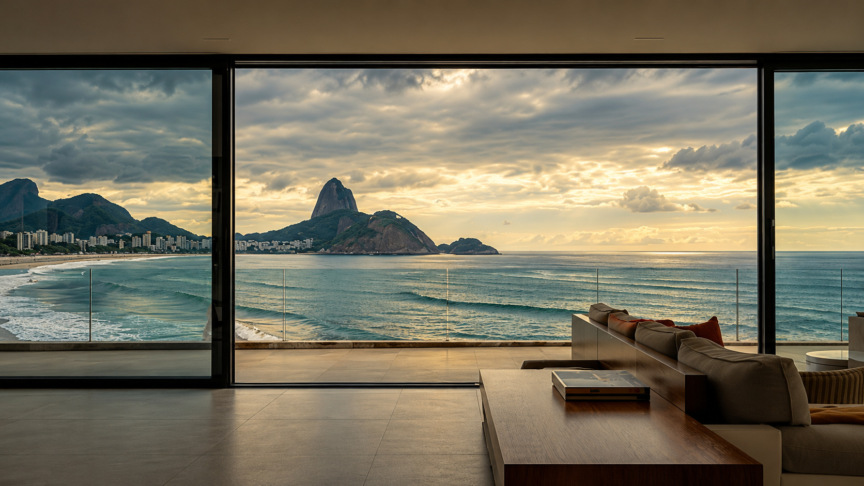
AZULA
12
Prototype evidence and early validation
Evidence | Current status
Studio demonstrations | Working local Studio: part-by-part models and blueprint drawing
Brand · Business HQ | Working local tool linked to the Map. Sample data only, no users yet
Public showcase | Demo website: 12 centers with real footage, the Void, both studios
Early validation | 4 interviews. 1 informal tester. $0 revenue.
AI integration is unfinished. Corporate demand, repeat use and willingness to pay remain unvalidated.
Notes:
The existing capability audit records a working local interface, authored models and captured interactions. The home graph reports 1,308 notes and 7,976 connections. The intake checkpoint records 12 PDFs, 501 extracted pages and 337 filed Reel source specifications, with zero fully watched Reels. Library volume is not customer traction, source verification, model training or an accuracy benchmark. Founder confirmed no current income; current revenue is $0. The founder reports one friend informally trying Azula. This is early prototype testing, not measured active-user traction. Retention and willingness to pay have not been measured.
Product evidence: dated local application captures and capability audit, 21 October 2026. Public research checked 21 October 2026. Founder facts updated 25 October 2026. LinkedIn: https://www.linkedin.com/in/jeremiah-white-a90012283. Instagram: https://www.instagram.com/jeremiahwhiteee/. Business hypotheses and targets are proposals, not results. Founder identification: Jeremiah White, Founder of Azula. Venture not yet incorporated.
Current founder-confirmed evidence: four potential-customer interviews, one informal tester, zero revenue, and no LOIs, preorders or signed customers. AI integration remains unfinished. Brand management and tracking are founder-reported. This revision does not claim automated monitoring, competitor intelligence, brand analytics, enterprise security, collaboration or production integrations.
Updated 26 October 2026 to match the demo website. Images are real captures from the local prototype (personal details blurred); Business HQ screens use sample entries, not a real company’s figures. Business HQ replaced the founder-reported brand management line: it is now a working local tool (built 26 October 2026), shown with sample data and with no users yet. The demo website shows real footage of nine centers, a ten-world Void tour and Studio models.

Slide 13
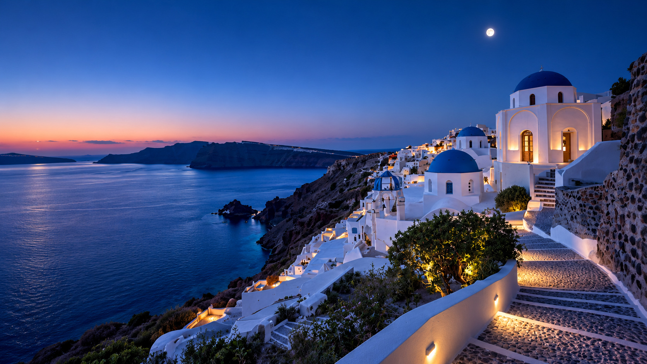
AZULA
13
Raising $250,000
Product reliability, AI integration
and a measured pilot.
Jeremiah White, Founder of Azula
jeremiahjwhitehq@gmail.com
Live demo: azula-by-jeremiah-white.copperball24.chatgpt.site
LinkedIn: linkedin.com/in/jeremiah-white-a90012283
Instagram: instagram.com/jeremiahwhiteee
Valuation, instrument and terms remain undecided.
$2,560 founder hardware investment. $0 outside commitments. $0 funding received. $0 revenue.
Notes:
Jeremiah White confirmed a $199,000 target on 22 October 2026; on 26 October 2026, the current raise target was updated to $250,000. He clarified that the previously reported $2,560 commitment is his personal hardware investment. Outside investor commitments are $0, external funding received is $0 and revenue is $0. The hardware includes a gaming laptop, another Acer laptop, monitor and cooling equipment. This is founder investment in the prototype, not commercial traction or proof of production capacity. The proposed use of funds is engineering, domain review, a measured pilot, infrastructure and company/content readiness. Terms, instrument and valuation remain open. The founder estimated approximately five months of runway at current scope on 24 October 2026. The raise does not imply a validated runway forecast. Product evidence: dated local application captures and capability audit, 21 October 2026. Public research checked 21 October 2026. Founder facts updated 25 October 2026. LinkedIn: https://www.linkedin.com/in/jeremiah-white-a90012283. Instagram: https://www.instagram.com/jeremiahwhiteee/. Business hypotheses and targets are proposals, not results. Founder identification: Jeremiah White, Founder of Azula. Venture not yet incorporated.
The founder asked to remove the referral attribution on 25 October 2026. Future pitch materials should omit it. The $199,000 raise is the total target, with no outside funding or commitments.
Updated 26 October 2026 to match the demo website. Images are real captures from the local prototype (personal details blurred); Business HQ screens use sample entries, not a real company’s figures. The demo link opens the interactive demo section of the website: https://azula-by-jeremiah-white.copperball24.chatgpt.site/#interactive-demo

